Slide 1

Functions, Arrays, Vectors
Creating and Using Functions, Arrays in C++,
STL Vectors
Technical Trainers
Iliya Iliev
Polya Pavlova
Software University
http://softuni.bg

Slide 2

Table of Contents
Functions – Calling, Declaring, Defining
C++ Arrays
  Arrays in Programming
  Declaring & Initializing
  Usage with Functions
STL Vectors
  Dynamic-size arrays
  Using std::vector

Slide 3
Questions
sli.do
#cpp-fund

Slide 4
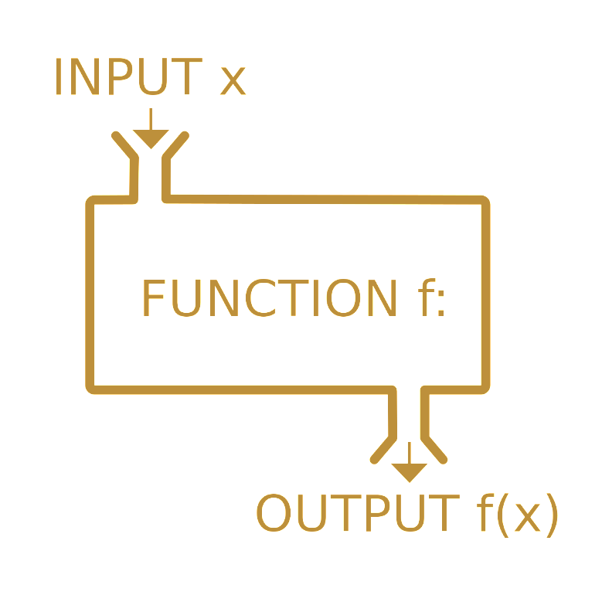
Functions
Calling, Defining, Implementing

Slide 5
What is a Function
A named block that performs a specific task
  Can be called from other code
  Can take parameters and return a value
Also known as methods
main() is a function
  int main()
  {
    return 0;
  }

Slide 6
Calling Functions
Using functions is almost like using variables, however:
  You write () after them, which could contain parameters
Most functions return a value – you can use it in an expression
  Just like you would use a variable's value
  void functions don't have values, they just do something
#include<iostream>
void HelloWorld()
{
  std::cout << "Hello World!" << std::endl;
}
int main() {
  HelloWorld();
return 0;
}

Slide 7
Calling Functions
LIVE DEMO

Slide 8
Declaring and Defining Functions
#include<iostream>
int getMax(int a, int b) {
int maxValue;
if (a > b) {
maxValue = a;
} else {
maxValue = b;
}
return maxValue;
}
int main() {
std::cout << getMax(5, 7) << std::endl;
return 0;
}
Declare the function
  return type (i.e. value)
  name
  parameters
Define the body
  always in a block
  contains the actual code
Call with name followed by () containing parameters

Slide 9
Declaring and Defining Functions
LIVE DEMO

Slide 10
Function Declaration
Declaration – function's name, return type and parameters
  Can be separate from definition (which includes the code block)
Syntax: ReturnType functionName(parameters);
Parameters: empty, single, or several separated by , (comma)
  Syntax: DataType [parameterName [= defaultValue]]
int getMax(int a, int b);
int getMax(int, int);
int getMax(int a = 0, int b = 0);

Slide 11
Function Declaration vs. Definition
Declaration – tells the compiler
there is such a function
  Can be anywhere
  Can appear multiple times
  Same visibility rules as for variables
Definition – tells the compiler
what the function does
Can be declared but not defined –
compilation error if called
#include<iostream>
void HelloWorld();
int main() {
  HelloWorld();
return 0;
}
void HelloWorld()
{
  std::cout << "Hello World!" << std::endl;
}

Slide 12
Declaring vs. Defining Functions
LIVE DEMO

Slide 13
Parameters & Default Values
Parameters are just variables living in the function’s block
Parameters with default values can be omitted by the caller
  If omitted are initialized with the default value
  Must be last in the parameter list
#include <iostream>
void CountNumbers( int a = 1, int b = 10 )
{
for( int i = a; i <= b; i++ )
{
std::cout << i << std::endl;
}
}
int main()
{
CountNumbers( 5, 10 );
return 0;
}

Slide 14
Returning Values from Functions
The return keyword determines the function's return value
return immediately exits the function
  Non-void functions must have a return followed by a value
int getMax(int a, int b) {
if (a > b) {
return a;
}
return b;
}

Slide 15
Parameters and Returning Values
LIVE DEMO

Slide 16
static Variables Inside Functions
static variables live through entire program, initialized once
static variables can be used inside functions to track state
  E.g. how many times a function was called
void CountNumbers( int a = 1, int b = 10 )
{
static int num = 0;
for( int i = a; i <= b; i++ )
{
cout << i << endl;
num++;
}
cout << "Static int -> " << num << endl;
}

Slide 17
Static Variables Inside Functions
LIVE DEMO

Slide 18
0 1 2 3 4
… | … | … | … | …
Arrays
Multiple Values Inside One Variable

Slide 19
What are Arrays?
In programming, an array is a sequence of elements
  Elements are numbered from 0 to Length-1
  Elements are of the same type (e.g. integers)
  Arrays have fixed size – cannot be resized
0 1 2 3 4
Element index
Array of 5 elements
… | … | … | … | …
Element
of an array

Slide 20
Creating C++ Arrays
Declaring: DataType identifier [arraySize];
C++ arrays have some special initialization syntax
  DataType identifier[N] = {elem0, elem1, ..., elemN-1}
  There can be less than N elements, but not more
Example: int numbers[5] = {10,9,12,31,15};
Index | 0 | 1 | 2 | 3 | 4
Value | 10 | 9 | 12 | 31 | 15

Slide 21
C++ Array Declaration & Initialization
C++ Array size must be an integer, known compile-time
  i.e. size can be a literal
  or a const value/expression
double numbers[7];
const int NumLetters = 26;
char alphabet[NumLetters];

Slide 22
C++ Array Initialization
{} initializes elements (comma-separated values)
  if less values than array size -> remaining get default values
  if more values than array size -> compilation error
Other rules are the same as for primitives
  Can only be initialized once
  Can be made const
double values[3] = {3.14};
double sameValues[3] = {3.14, 0, 0};

Slide 23
0 1 2 3 4
… | … | … | … | …
Creating C++ Arrays
LIVE DEMO

Slide 24
Accessing Array Elements
The indexing operator [] gives access to any array element
  array[index] = value; DataType value = arrayName[index]
Once you access the element, treat it as a normal variable
int array[3] = { 20, 30, 40 };
cout << "First->" << array[0]
<< "Second->"<< array[1]
<< "Third->" << array[2] << endl;

Slide 25
0 1 2 3 4
… | … | … | … | …
Accessing Array Elements
LIVE DEMO

Slide 26
Reading-in an Array
Arrays are often read-in from some input, instead of initialized
That’s the point of arrays – to store arbitrary amounts of data
Common approach: run a loop to read-in a number of elements
  Example: read-in a specified number of elements from console

Slide 27
Writing-out an Array
You will commonly need to display all elements of an array
Common approach: loop over the elements, print each
Note: need to know how long the array is – keep a variable

Slide 28
Reading-in and Writing-out an Array
int lenght = 0;
cout << "Enter a lenght of array:" << endl;
cin >> lenght;
int array[lenght];
cout << "Enter elements in array:" << endl;
for( int i = 0; i < lenght; i++ )
{
cin >> array[i];
}
cout << "Elements in array:" << endl;
for( int i = 0; i < lenght; i++ )
{
cout << array[i] << " ";
}
cout << endl;
cout << "End of elements" << endl;

Slide 29
0 1 2 3 4
… | … | … | … | …
Reading-in and Writing-out Arrays
LIVE DEMO

Slide 30
Arrays as Function Parameters
Array parameters are declared the same way arrays are declared
  First dimension size can be omitted in array parameter
  Usually necessary to add an int with the size
void print(int a[], int size) {
for (int i = 0; i < size; i++) {
cout << a[i] << " ";
}
cout << endl;
}
int main() {
int numbers[] = {1,2,3};
print(numbers, 3);
return 0;
}

Slide 31
C++11 Range-Based for Loop
Tired of writing for loops with indices to iterate over an array?
C++11 added a loop for that use-case
Syntax (for arrays): for (DataType element : array)
  Body will execute once for each element in the array
  On each iteration, element will be the next item in the array
int numbers[] = {13, 42, 69};
for (int i : numbers) {
cout << i << endl;
}

Slide 32
0 1 2 3 4
… | … | … | … | …
C++11 Range-Based for Loop
LIVE DEMO

Slide 33

LIVE DEMO
STL Vectors
C++ Dynamically-Sized Arrays

Slide 34
STL Vector Basics
The C++ std::vector class is a resizable array
  Has normal array-like access – [] operator
  Knows it's size (.size()), can add elements (.push_back())
#include<vector>
Acts like a normal variable
  Can be assigned like a normal variable
  Can be returned from a function

Slide 35
Initializing a Vector
Declaration Syntax: std::vector<T> name;
The vector is initially empty – items need to be added
  Call push_back(T element) on the vector to add elements
Can be initialized directly in C++11 with {} syntax
  std::vector<int> numbers {13, 42, 69};
  std::vector<int> numbers = {13, 42, 69};
std::vector<int> myVector;
for (int i = 0; i < 100; i++)
{
myVector.push_back( i + 10 );
}

Slide 36
Initializing STL Vectors
LIVE DEMO

Slide 37
Returning STL Vectors from Functions
Vectors act as normal variables when returned
  Function returns a copy
vector<double> getSquareRoots(int from, int to) {
vector<double> roots;
for (int i = from; i <= to; i++) {
roots.push_back(sqrt(i));
}
return roots;
}
int main() {
print(getSquareRoots(4, 25));
return 0;
}
void print(vector<double> numbers) {
for (int number : numbers) {
cout << number << " "
}
cout << endl;
}

Slide 38
Returning STL Vectors from Functions
LIVE DEMO

Slide 39

Summary
Functions are named, reusable blocks of code
  Can accept parameters and return values
Arrays are sequences of numbered elements
STL Vectors are objects that represent arrays which can resize
  Can mostly be used instead of arrays for basic tasks

Slide 41
Softuni Diamond Partners

Slide 42
Softuni Diamond Partners

